Slide 1
Chapter 14 Normalization

Slide 2
Normal Forms Based on Primary Keys
Definitions of Keys and Attributes Participating in Keys
If a relation schema has more than one key, each is called a candidate key.
One of the candidate keys is arbitrarily designated to be the primary key, and the others are called secondary keys.
In a practical relational database, each relation schema must have a primary key.
If no candidate key is known for a relation, the entire relation can be treated as a default superkey.
{Ssn} is the only candidate key for EMPLOYEE, so it is also the primary key.

Slide 3
Normal Forms Based on Primary Keys
Definitions of Keys and Attributes Participating in Keys
Definition. An attribute of relation schema R is called a prime attribute of R if it is a member of some candidate key of R.
An attribute is called nonprime if it is not a prime attribute—that is, if it is not a member of any candidate key.
Ssn and Pnumber are prime attributes of WORKS_ON, whereas other attributes of WORKS_ON are nonprime.

Slide 4
Normal Forms Based on Primary Keys
First Normal Form
It states that the domain of an attribute must include only atomic (simple, indivisible) values and that the value of any attribute in a tuple must be a single value from the domain of that attribute.
Hence, 1NF disallows having a set of values, a tuple of values, or a combination of both as an attribute value for a single tuple.
The only attribute values permitted by 1NF are single atomic (or indivisible) values.

Slide 5
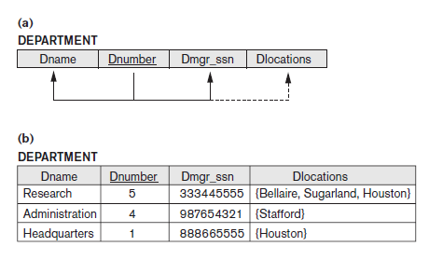
Normal Forms Based on Primary Keys
First Normal Form
Consider the DEPARTMENT relation schema shown in Figure 14.1, whose primary key is Dnumber, and suppose that we extend it by including the Dlocations attribute as shown in Figure 14.9(a).
We assume that each department can have a number of locations.
As we can see, this is not in 1NF because Dlocations is not an atomic attribute, as illustrated by the first tuple in Figure 14.9(b).

Slide 6
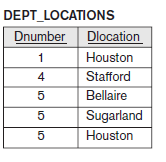
Normal Forms Based on Primary Keys
First Normal Form
SOLUTION:
Remove the attribute Dlocations that violates 1NF and place it in a separate relation DEPT_LOCATIONS along with the primary key Dnumber of DEPARTMENT.
The primary key of this newly formed relation is the combination {Dnumber, Dlocation}, as shown in Figure 14.2.
A distinct tuple in DEPT_LOCATIONS exists for each location of a department.
This decomposes the non-1NF relation into two 1NF relations.

Slide 7
Normal Forms Based on Primary Keys
Second Normal Form
Second normal form (2NF) is based on the concept of full functional dependency.
A functional dependency X → Y is a full functional dependency if removal of any attribute A from X means that the dependency does not hold anymore; that is, for any attribute A ε X, (X − {A}) does not functionally determine Y.
A functional dependency X → Y is a partial dependency if some attribute A ε X can be removed from X and the dependency still holds; that is, for some A ε X, (X − {A}) → Y.
In Figure 14.3(b), {Ssn, Pnumber} → Hours is a full dependency (neither Ssn → Hours nor Pnumber → Hours holds).
However, the dependency {Ssn, Pnumber} → Ename is partial because Ssn → Ename holds.
Definition: A relation schema R is in 2NF if every nonprime attribute A in R is fully functionally dependent on the primary key of R.

Slide 8
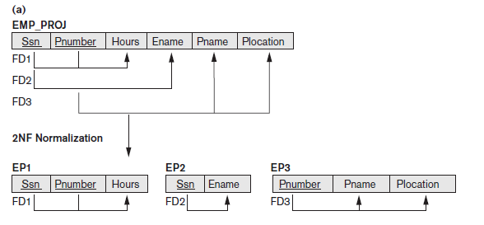
Normal Forms Based on Primary Keys
Second Normal Form
The test for 2NF involves testing for functional dependencies whose left-hand side attributes are part of the primary key.
The EMP_PROJ relation in Figure 14.3(b) is in 1NF but is not in 2NF.
The nonprime attribute Ename violates 2NF because of FD2, as do the nonprime attributes Pname and Plocation because of FD3.

Slide 9
Normal Forms Based on Primary Keys
Second Normal Form
Each of the functional dependencies FD2 and FD3 violates 2NF because Ename can be functionally determined by only Ssn, and both Pname and Plocation can be functionally determined by only Pnumber. Attributes Ssn and Pnumber are a part of the primary key {Ssn, Pnumber} of EMP_PROJ, thus violating the 2NF test.

Slide 10
Normal Forms Based on Primary Keys
Third Normal Form
Third normal form (3NF) is based on the concept of transitive dependency.
A functional dependency X → Y in a relation schema R is a transitive dependency if there exists a set of attributes Z in R that is neither a candidate key nor a subset of any key of R, and both X → Z and Z → Y hold.
The dependency Ssn → Dmgr_ssn is transitive through Dnumber in EMP_DEPT in Figure 14.3(a), because both the dependencies Ssn → Dnumber and Dnumber → Dmgr_ssn hold and Dnumber is neither a key itself nor a subset of the key of EMP_DEPT.
We can see that the dependency of Dmgr_ssn on Dnumber is undesirable in EMP_DEPT since Dnumber is not a key of EMP_DEPT.
Definition. A relation schema R is in 3NF if it satisfies 2NF and no nonprime attribute of R is transitively dependent on the primary key.

Slide 11
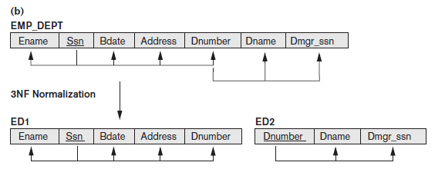
Normal Forms Based on Primary Keys
Third Normal Form
The relation schema EMP_DEPT in Figure 14.3(a) is in 2NF, since no partial dependencies on a key exist.
However, EMP_DEPT is not in 3NF because of the transitive dependency of Dmgr_ssn (and also Dname) on Ssn via Dnumber.
We can normalize EMP_DEPT by decomposing it into the two 3NF relation schemas ED1 and ED2 shown in Figure 14.11(b).

Slide 12
Normal Forms Based on Primary Keys
Third Normal Form
A NATURAL JOIN operation on ED1 and ED2 will recover the original relation EMP_DEPT without generating spurious tuples.

Slide 13
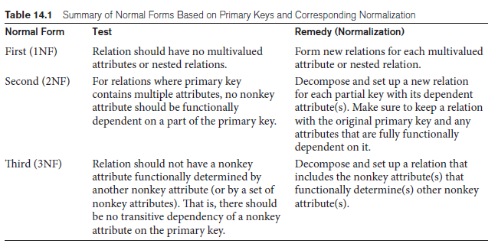
General Definitions of Second and Third Normal Forms

Slide 14
General Definitions of Second and Third Normal Forms
General Definition of Second Normal Form
Definition. A relation schema R is in second normal form (2NF) if every nonprime attribute A in R is not partially dependent on any key of R.
The test for 2NF involves testing for functional dependencies whose left-hand side attributes are part of the primary key.
If the primary key contains a single attribute, the test need not be applied at all.
Consider the relation schema LOTS shown in Figure 14.12(a), which describes parcels of land for sale in various counties of a state.
Suppose that there are two candidate keys:
Property_id# and {County_name, Lot#}
that is, lot numbers are unique only within each county, but Property_id# numbers are unique across counties for the entire state.

Slide 15
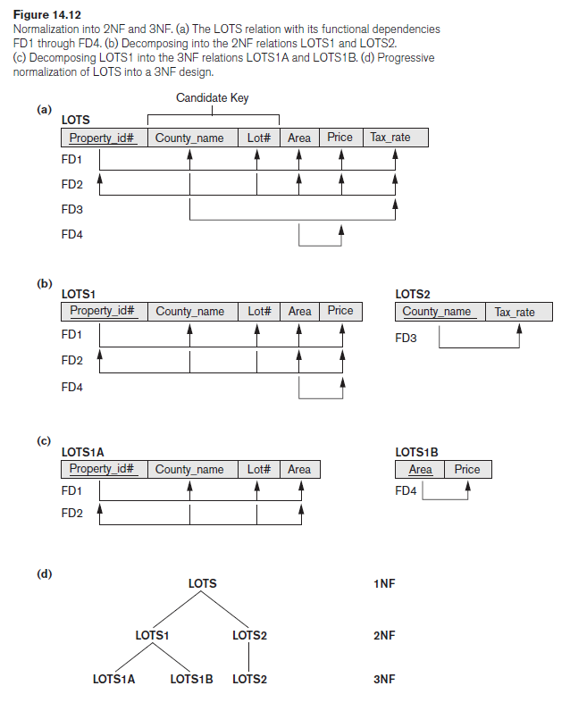
General Definitions of Second and Third Normal Forms

Slide 16
General Definitions of Second and Third Normal Forms
General Definition of Second Normal Form
Based on the two candidate keys Property_id# and {County_name, Lot#}, the functional dependencies FD1 and FD2 in Figure 14.12(a) hold.
Suppose that the following two additional functional dependencies hold in LOTS:
FD3: County_name → Tax_rate
FD4: Area → Price
The dependency FD3 says that the tax rate is fixed for a given county (does not vary lot by lot within the same county),
FD4 says that the price of a lot is determined by its area regardless of which county it is in.

Slide 17
General Definitions of Second and Third Normal Forms
General Definition of Second Normal Form
The LOTS relation schema violates the general definition of 2NF because Tax_rate is partially dependent on the candidate key {County_name, Lot#}, due to FD3.
To normalize LOTS into 2NF, we decompose it into the two relations LOTS1 and LOTS2.
We construct LOTS1 by removing the attribute Tax_rate that violates 2NF from LOTS and placing it with County_name (the left-hand side of FD3 that causes the partial dependency) into another relation LOTS2.
Both LOTS1 and LOTS2 are in 2NF. Notice that FD4 does not violate 2NF and is carried over to LOTS1.

Slide 18
General Definitions of Second and Third Normal Forms
General Definition of Third Normal Form
Definition. A relation schema R is in third normal form (3NF) if, whenever a nontrivial functional dependency X → A holds in R, either (a) X is a superkey of R, or (b) A is a prime attribute of R.
FD4 in LOTS1 violates 3NF because Area is not a superkey and Price is not a prime attribute in LOTS1.
To normalize LOTS1 into 3NF, we decompose it into the relation schemas LOTS1A and LOTS1B.
We construct LOTS1A by removing the attribute Price that violates 3NF from LOTS1 and placing it with Area (the left-hand side of FD4 that causes the transitive dependency) into another relation LOTS1B.

Slide 19
General Definitions of Second and Third Normal Forms
General Definition of Third Normal Form
Two points are worth noting about this example and the general definition of 3NF:
■ LOTS1 violates 3NF because Price is transitively dependent on each of the candidate keys of LOTS1 via the nonprime attribute Area.
■ This general definition can be applied directly to test whether a relation schema is in 3NF; it does not have to go through 2NF first. In other words, if a relation passes the general 3NF test, then it automatically passes the 2NF test.
If we apply the above 3NF definition to LOTS with the dependencies FD1 through FD4, we find that both FD3 and FD4 violate 3NF by the general definition above because the LHS County_name in FD3 is not a superkey.

Slide 20
General Definitions of Second and Third Normal Forms
Interpreting the General Definition of Third Normal Form
A relation schema R violates the general definition of 3NF if a functional dependency X → A holds in R that meets either of the two conditions, namely (a) and (b).
The first condition “catches” two types of problematic dependencies:
■ A nonprime attribute determines another nonprime attribute. Here we typically have a transitive dependency that violates 3NF.
■ A proper subset of a key of R functionally determines a nonprime attribute. Here we have a partial dependency that violates 2NF.

Slide 21
General Definitions of Second and Third Normal Forms
Interpreting the General Definition of Third Normal Form
Therefore, we can state a general alternative definition of 3NF as follows:
Alternative Definition. A relation schema R is in 3NF if every nonprime attribute of R meets both of the following conditions:
■ It is fully functionally dependent on every key of R.
■ It is nontransitively dependent on every key of R.

Slide 22
Boyce-Codd Normal Form
Boyce-Codd Normal Form
Boyce-Codd normal form (BCNF) was proposed as a simpler form of 3NF, but it was found to be stricter than 3NF.
That is, every relation in BCNF is also in 3NF; however, a relation in 3NF is not necessarily in BCNF.
Definition. A relation schema R is in BCNF if whenever a functional dependency X → A holds in R, then X is a superkey of R.

Slide 23
Boyce-Codd Normal Form
Boyce-Codd Normal Form
Suppose that we have thousands of lots in the relation but the lots are from only two counties: DeKalb and Fulton.
Suppose also that lot sizes in DeKalb County are only 0.5, 0.6, 0.7, 0.8, 0.9, and 1.0 acres, whereas lot sizes in Fulton County are restricted to 1.1, 1.2, … , 1.9, and 2.0 acres.
In such a situation we would have the additional functional dependency FD5: Area → County_name.
Property_id# and {County_name, Lot#}

Slide 24
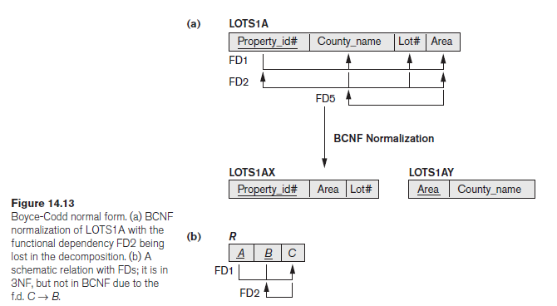
Boyce-Codd Normal Form
Boyce-Codd Normal Form

Slide 25
Boyce-Codd Normal Form
Boyce-Codd Normal Form
In our example, FD5 violates BCNF in LOTS1A because Area is not a superkey of LOTS1A.
We can decompose LOTS1A into two BCNF relations LOTS1AX and LOTS1AY, shown in Figure 14.13(a).
This decomposition loses the functional dependency FD2 because its attributes no longer coexist in the same relation after decomposition.
In practice, most relation schemas that are in 3NF are also in BCNF.

Slide 26

Boyce-Codd Normal Form
Decomposition of Relations not in BCNF
A relation TEACH with the following dependencies:
FD1: {Student, Course} → Instructor
FD2:Instructor → Course
Note that {Student, Course} is a candidate key for this relation.
Hence this relation is in 3NF but not BCNF.
Decomposition of this relation schema into two schemas is not straightforward because it may be decomposed into one of the three following possible pairs.

Slide 27
Boyce-Codd Normal Form
Three possible decompositions for relation TEACH
D1: {student, instructor} and {student, course}
D2: {course, instructor } and {course, student}
D3: {instructor, course } and {instructor, student} ✓
All three decompositions will lose fd1.
We have to settle for sacrificing the functional dependency preservation.
But we cannot sacrifice the non-additivity property after decomposition.
Out of the above three, only the 3rd decomposition will not generate spurious tuples after join.(and hence has the non-additivity property).

Slide 28
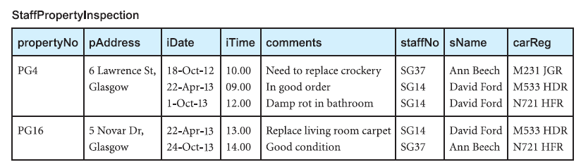
Boyce-Codd Normal Form
Example:

Slide 29
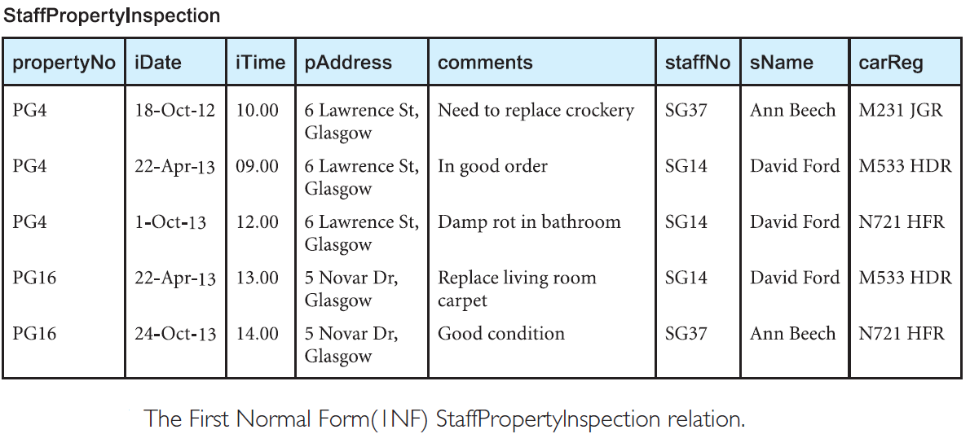
Boyce-Codd Normal Form
Example:

Slide 30
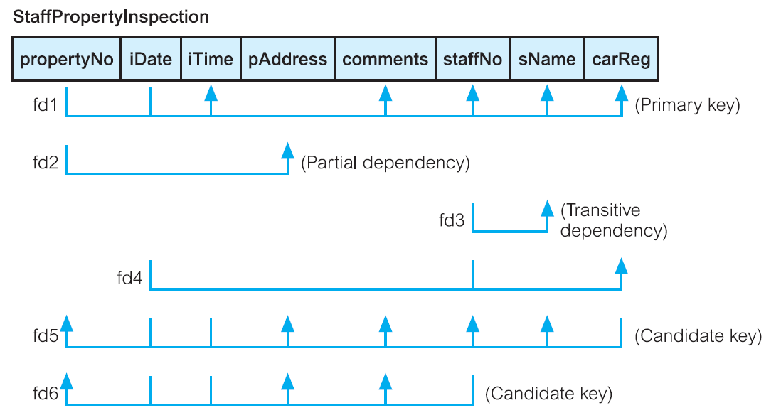
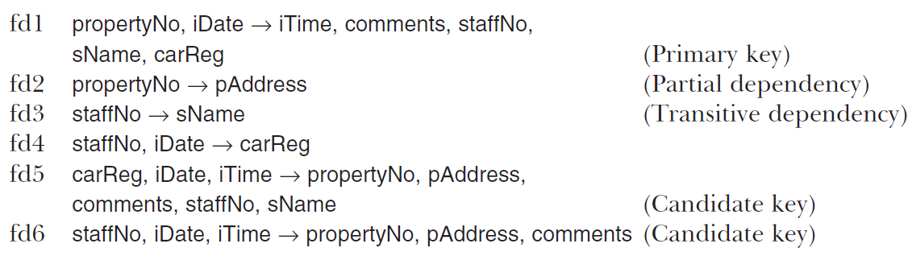
Boyce-Codd Normal Form
Example:

Slide 31
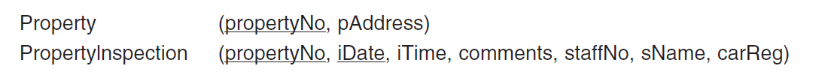
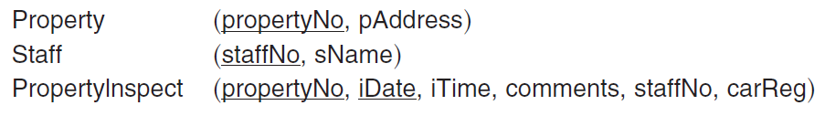

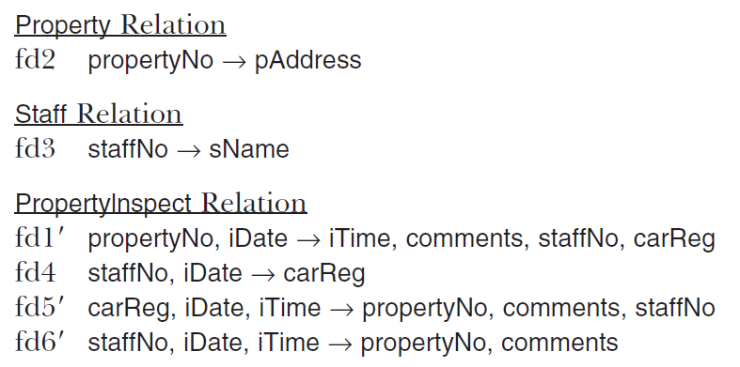
Second Normal Form (2NF)
Third Normal Form (3NF)
Boyce–Codd Normal Form (BCNF)

Slide 32
